Slide 1

Money Hub
John Neis & Samuel Dressler
G3

Slide 2
Introduction
Money Hub – A better way to manage your finances
Provide users with a comprehensive portal
Users should be “in the know”
Provide an option for people who don’t want to pay financial advisors
24/7 Constant access for all users

Slide 3
Design
Considerations
Testing and reliability
Network connectivity and usage
Server persistence
Development
Waterfall design method
Proof-of-concept prototyping
Component Reuse

Slide 4
Design
System Architecture
Query based
Client-Server relationship
Subsidiary client-server relationship between server and database

Slide 5
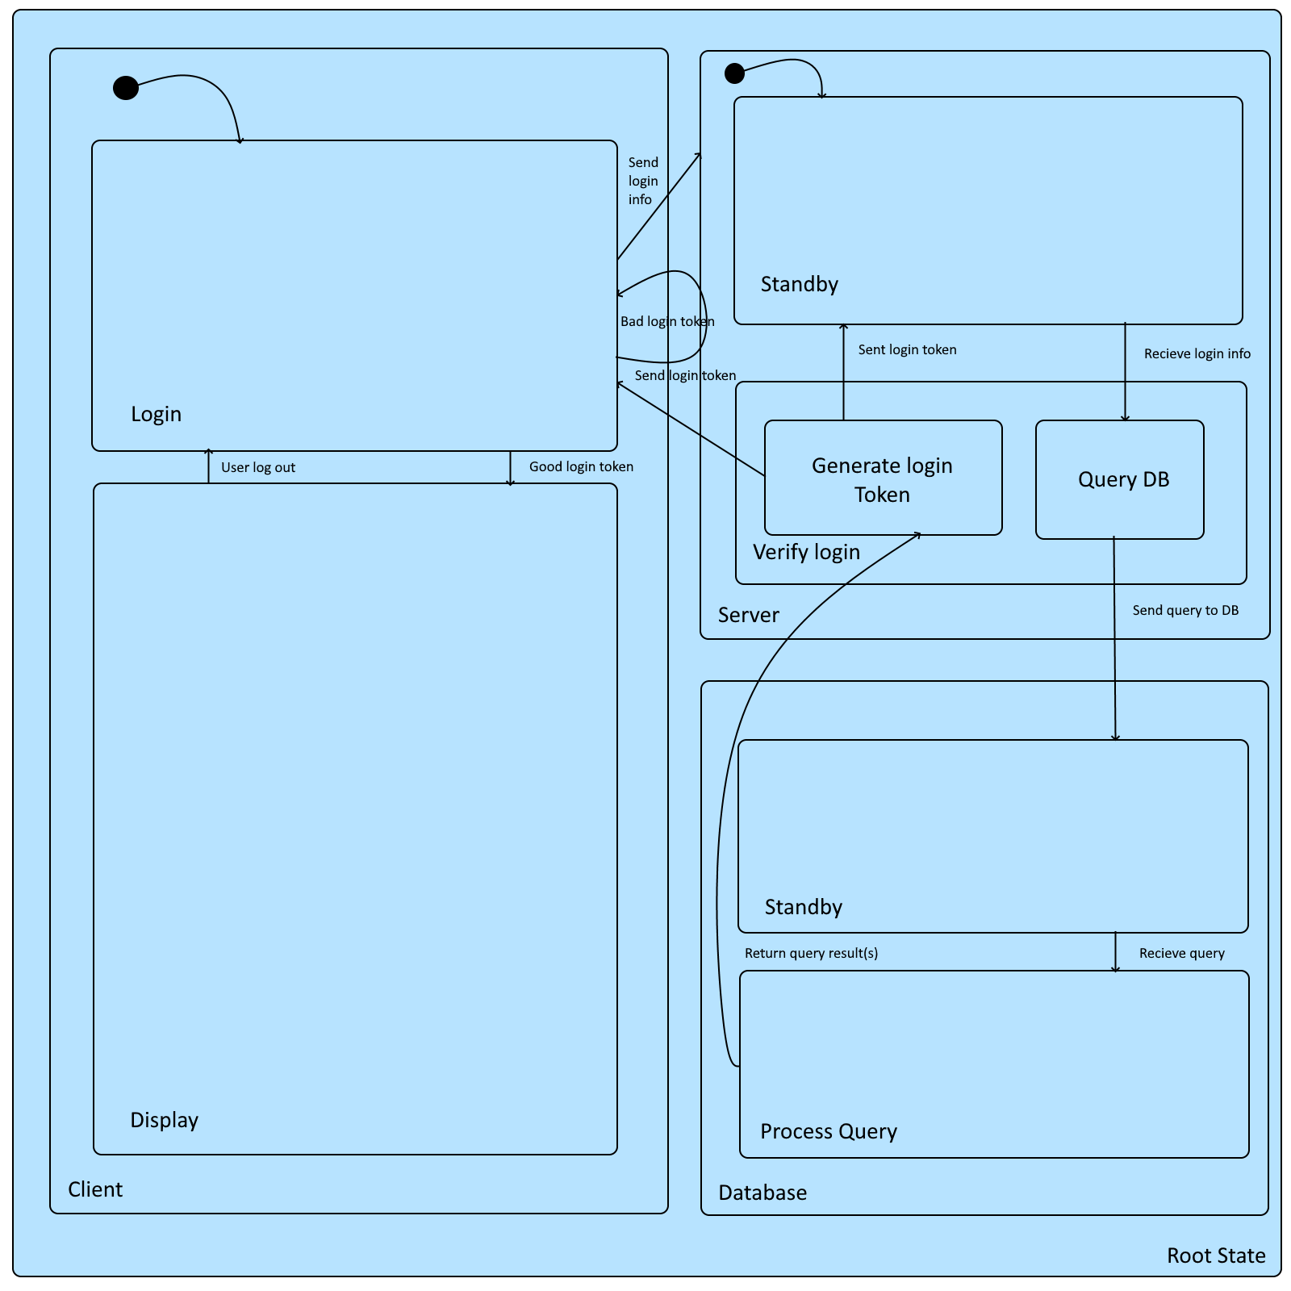
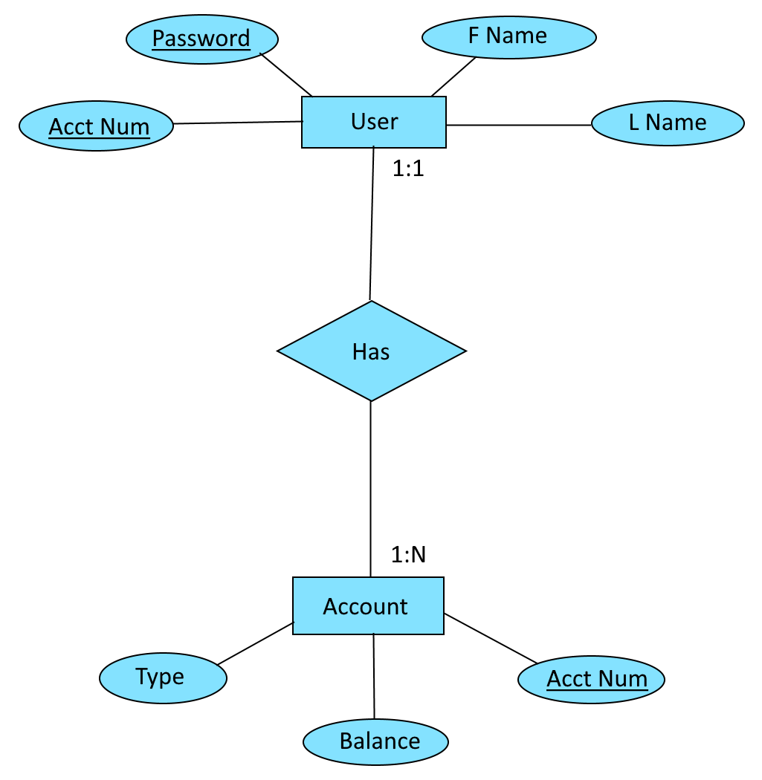
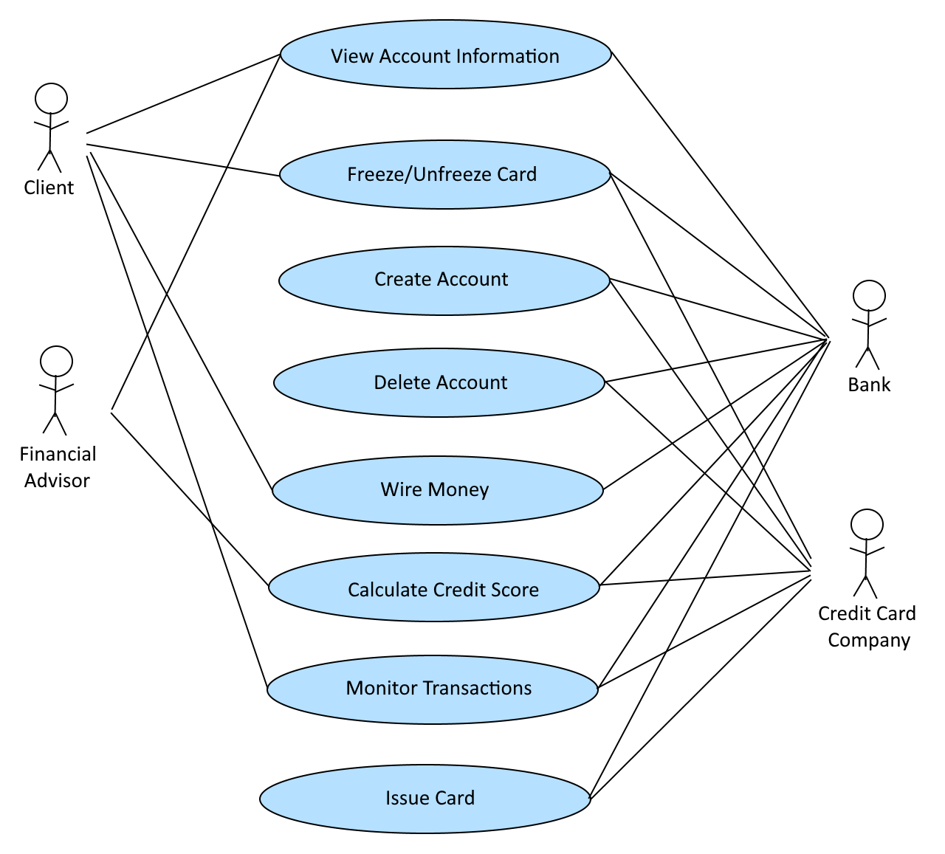
Design

Slide 6
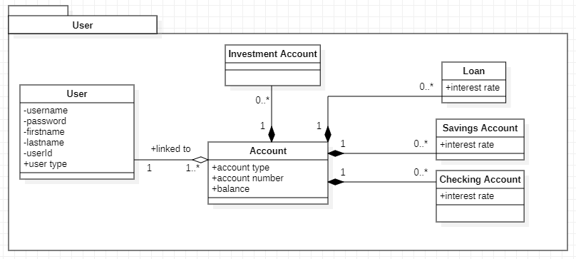
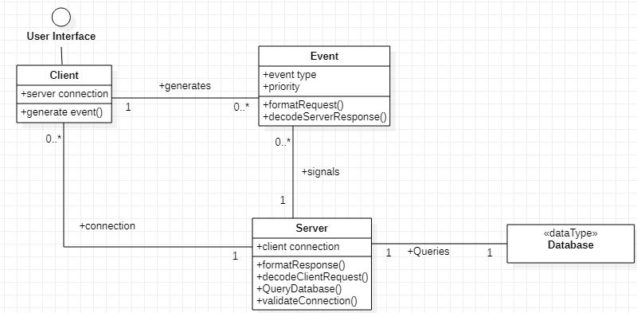
Design

Slide 7
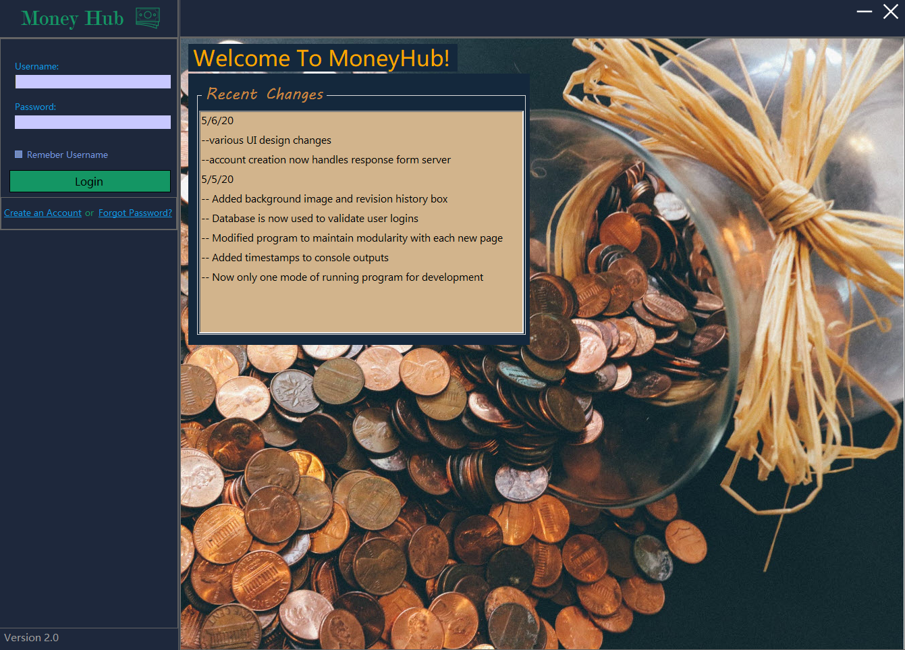
Design - UI

Slide 8
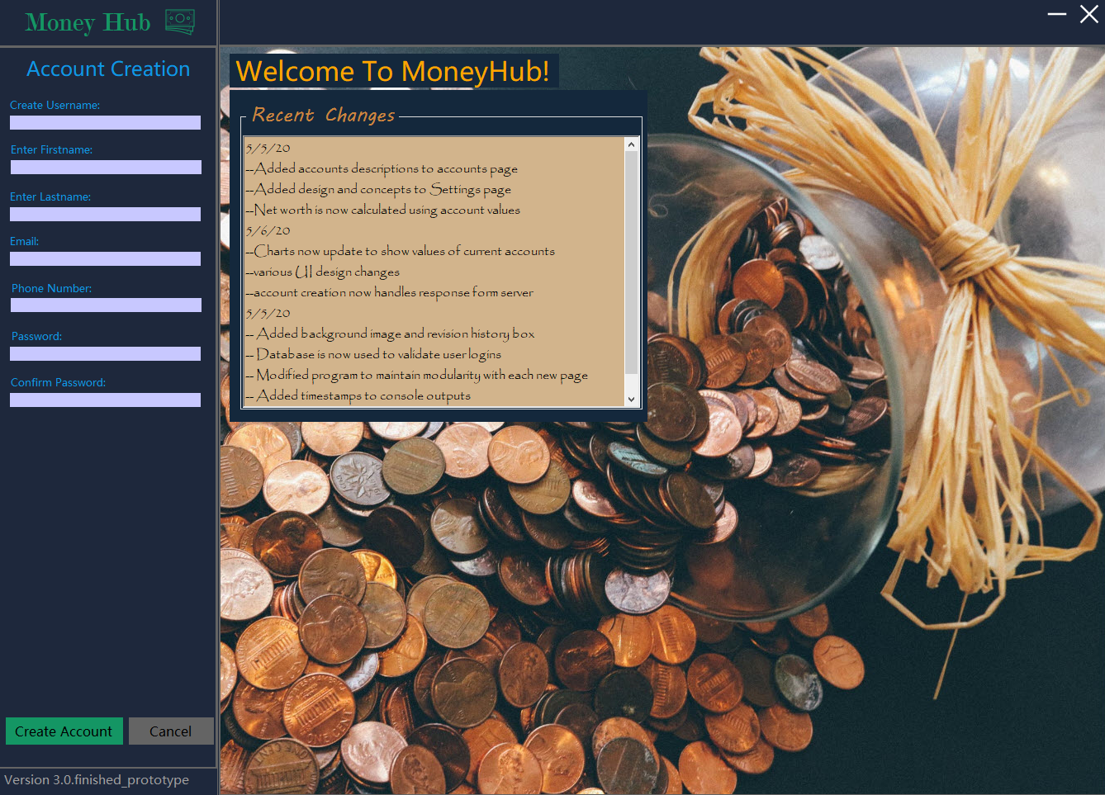
Design - UI

Slide 9
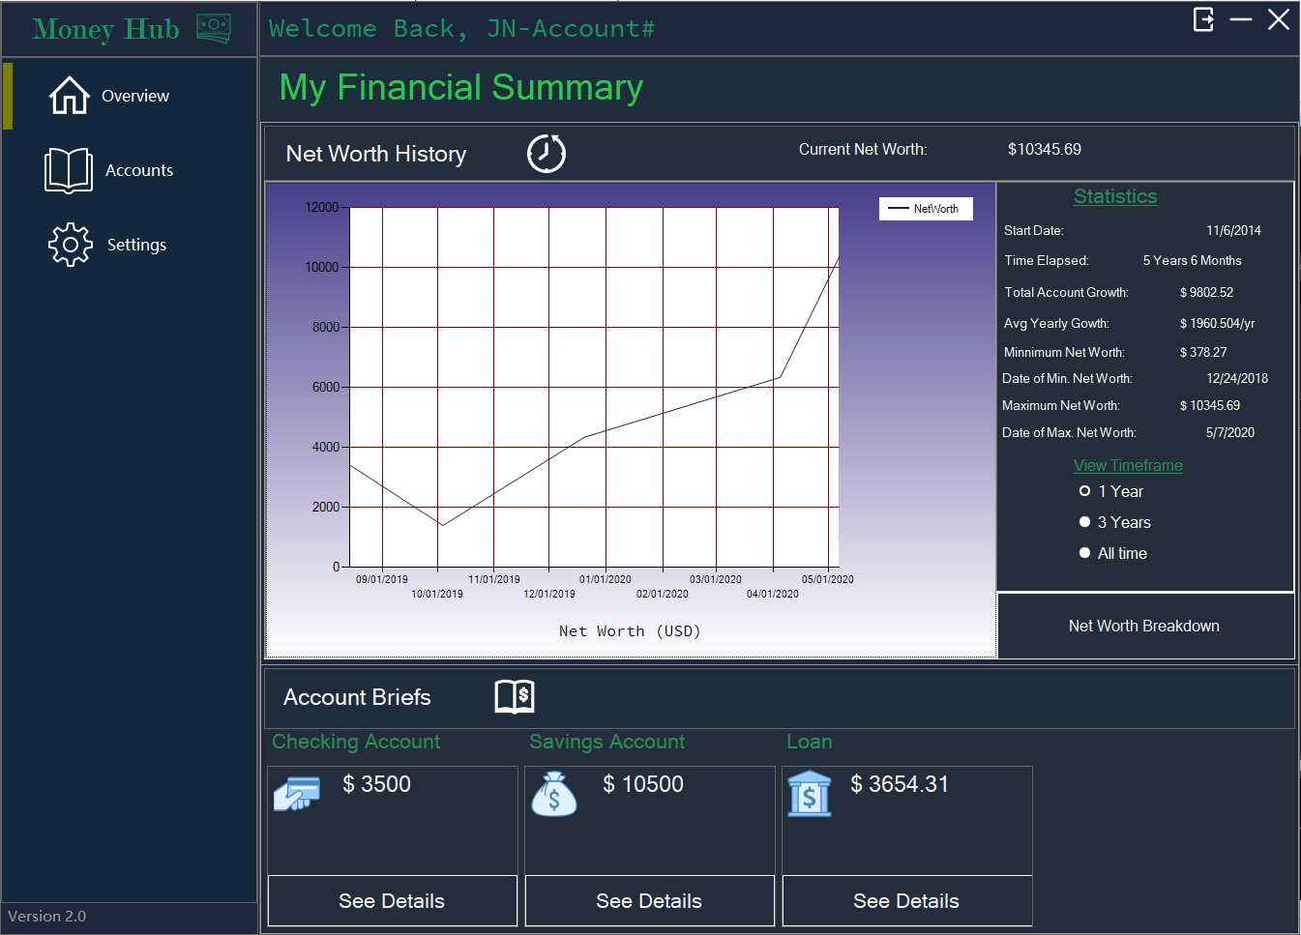
Design - UI

Slide 10
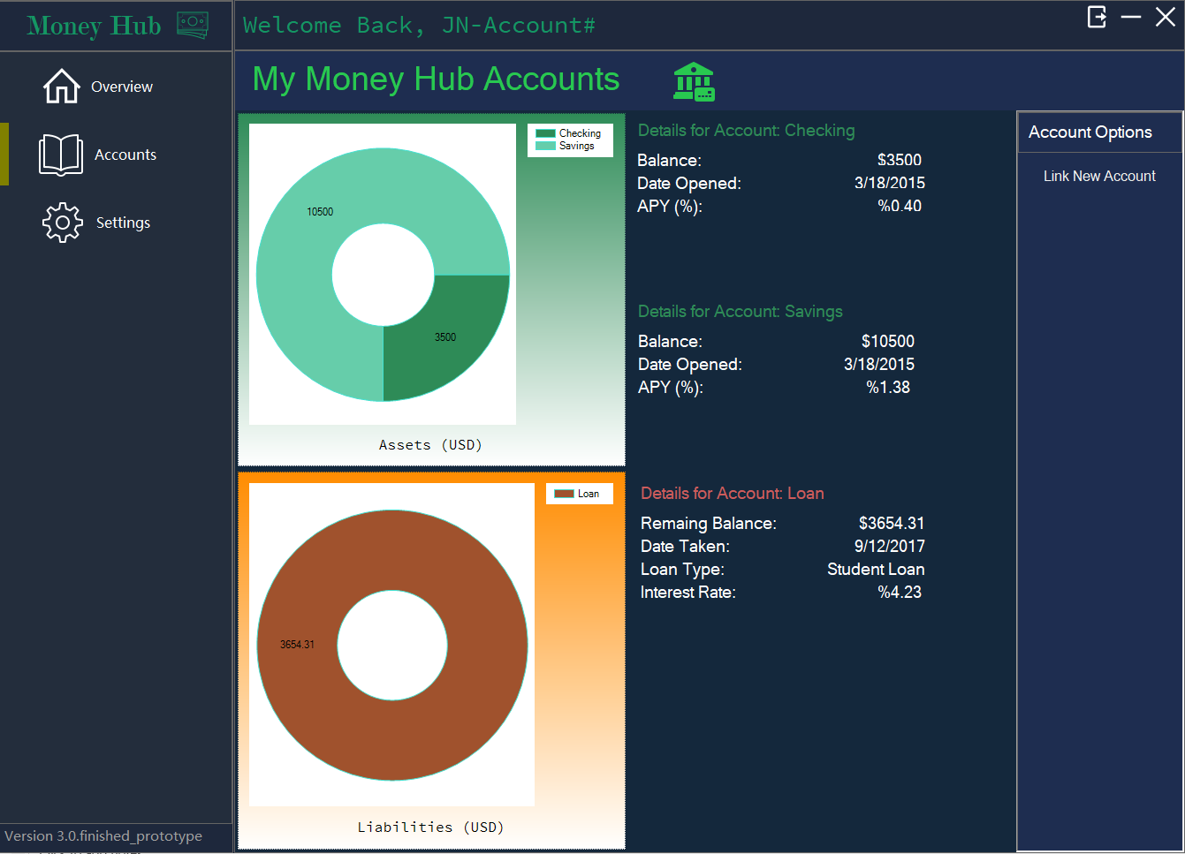
Design - UI

Slide 11
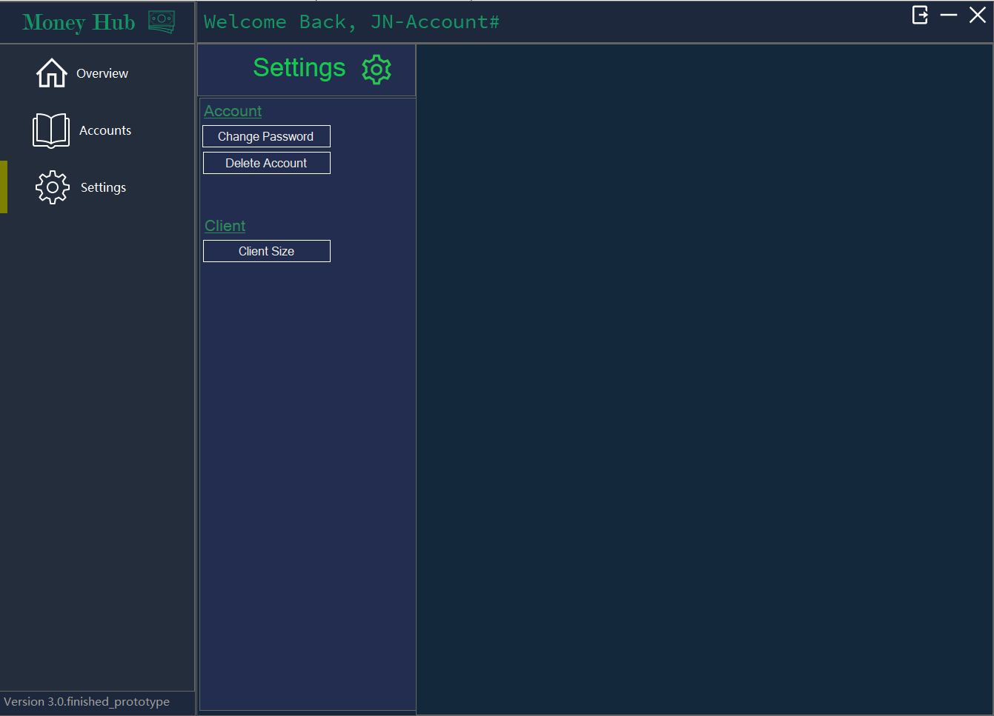
Design - UI

Slide 12
Future Work
Link accounts action / Create new accounts
Client loads all account information
Client Settings
Resize window
Change password / recover forgotten password
Delete accounts
Add more fields to the database

Slide 13
Tools
Development tools
Visual Studio 2019
Visual Studio Code
Windows PowerShell
Windows Subsystem for Linux – Ubuntu Terminal
MySQL Server 8.0
Paint.NET
StarUML

Slide 14
Tools
Programming Languages
Java
Visual C# w/ .NET Framework 4.7.2
SQL
Bash Shell

Slide 15
Tools
Networking Protocols
TCP/IP
Standard MySQL port: 3306
Java/C# .NET Sockets
Database Connectivity
MySQL JDBC driver for Java
Database connectivity strictly server-side

Slide 16
Tools
Record keeping and version control
Microsoft Word
Microsoft Excel
GitHub

Slide 17
Lessons Learned
Importance of project planning regarding
Cost Estimation
Time to complete estimation
System requirements
Scope of the system

Slide 18
Money Hub Demo

